Slide 1
WEB CRAWLER Apache Nutch 1.10
Instructor
Dr.C.C.Chan
Bhoomika
Divya
Jaswanth

Slide 2
Web Crawler
Web crawler is a program that traverses the hyperlinks structure of web pages.
We crawler visits each web page by following the hyperlinks on previous page it visits
Crawls web pages to extract hyperlinks, and also saves each page it has visited.

Slide 3
Apache Nutch 1.10
Nutch is a well matured, production ready Web crawler.
Nutch provides extensible interfaces such as Parse, Index and ScoringFilter's for custom implementations.
Nutch crawler to crawl on one machine.
Nutch runtime configuration including seed URL lists, URLFilters.

Slide 4
Web Crawler –Life cycle
bin/nutch inject crawl/crawldb urls
Inject
Generate
bin/nutch generate crawl/crawldb crawl/segments
fetching https://www.winndixie.com/about/vendors/nex-vendor-application
Fetch
bin/nutch updatedb crawl/crawldb $s1
CrawlDB Update
LinkDB
Index
bin/nutch solrdedup <solr url>
Dedup
Merge

Slide 5
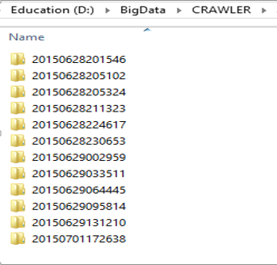
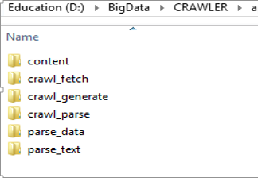
Steps involved in crawling
Nutch data is composed of:
The crawl database, or crawldb. This contains information about every URL known to Nutch, including whether it was fetched, and, if so, when.
The link database, or linkdb. This contains the list of known links to each URL, including both the source URL and anchor text of the link.
A set of segments. Each segment is a set of URLs that are fetched as a unit. Segments are directories with the following subdirectories:
a crawl_generate names a set of URLs to be fetched
a crawl_fetch contains the status of fetching each URL
a content contains the raw content retrieved from each URL
a parse_text contains the parsed text of each URL
a parse_data contains outlinks and metadata parsed from each URL
a crawl_parse contains the outlink URLs, used to update the crawldb

Slide 6
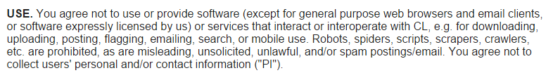
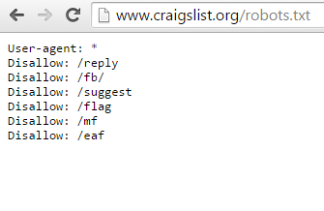
Failed Crawling with Craigslist
www.craigslist.org (our initial seed list)
We looked at Craigslist’s robots.txt to
to understand our failed crawling

Slide 7
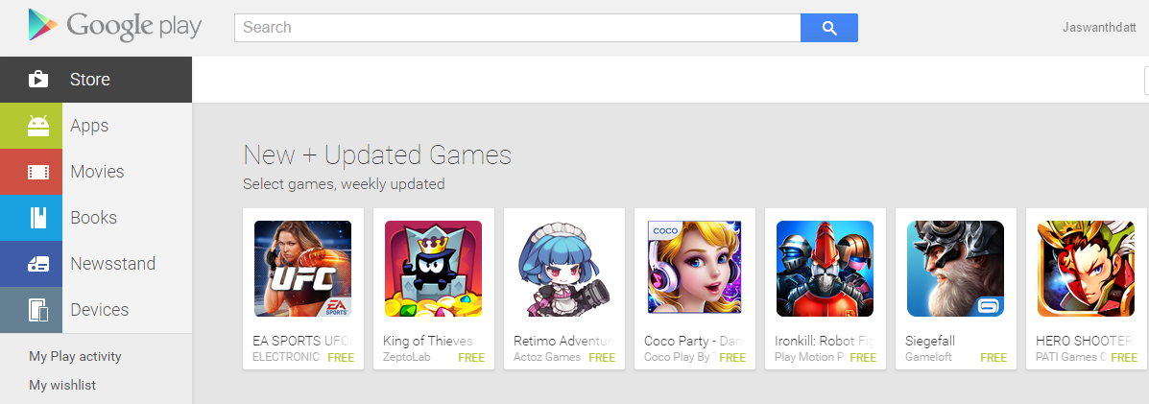
Url seed list (websites are not update daily)
https://play.google.com/store

Slide 8
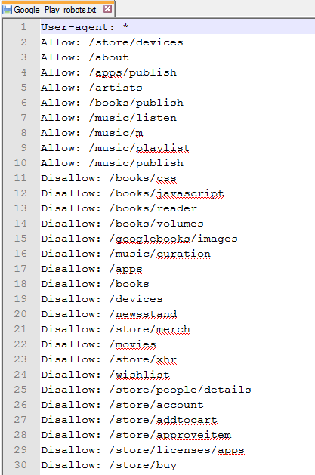
Robots.txt
Every website has policy for handling the search bots.
Before Crawling, it is very essential to have a look at robots.txt file for every website
In our case, for Google Play Store ,the permissions are present at https://play.google.com/robots.txt

Slide 9

Web Crawling Considerations
Is Web crawling very simple and straightforward?
Copyright Infringement.
Terms of Use That May Prohibit Automated Data Collection.
Damages Relating to Unauthorized Data Collection.

Slide 10
Web Crawling Considerations-Law suits
Facebook lawsuit against API Harvester
Craigslist sues Pad Mapper that plots apartment listings on a map from Craigslist data.
Baidu’s $15 Million Lawsuit Against Qihoo 360.
“No Crawling without written approval” in Mint.com Terms of Use
Yelp sued 80legs, a web crawler that automatically visits Yelp and gathers reviews

Slide 11
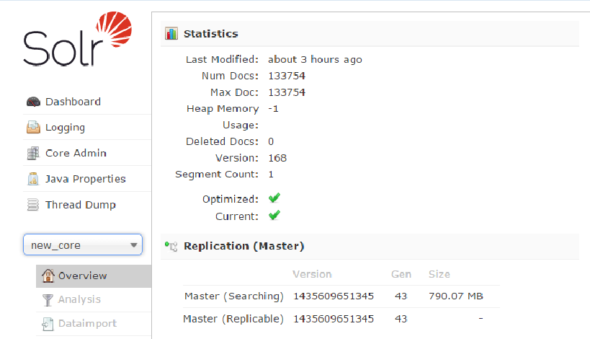
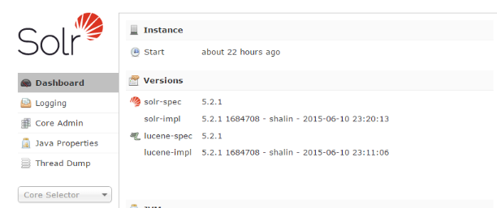
Statistics
We have collected a total of 133,754 documents.
We ran our nutch
crawler for 22 hours.
We have collected a total of 790.07 MB of data

Slide 12
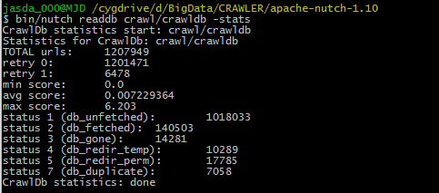
Urls stats
The total number of urls for all the 800 MB data that we have collected are 1,207,949
1,018,033 db_unfetched pages are linked to by
fetched pages, but not fetched yet
url filters
not in the TopN
140,503 db_fetched pages have been fetched and indexed.
14,281 db_gone pages have a 404 page not found status or some other presumably permanent error

Slide 13
Urls stats
The maximum score of the site using OPIC calculation with in-links and out-links score as 1 is 6.203
The website with maximum score is http://gmpg.org/xfn/11 6.203019
db.fetch.retry.max 3 default

Slide 14
Tika plugin Nutch-site.xml
<property>
<name>plugin.includes</name>
<value>protocol-http|urlfilter-regex|parse-(html|tika|text)|index-(basic|anchor)|scoring-opic|urlnormalizer-(pass|regex|basic)|language-identifier
</value>
</property>
Nutch Tika helps to parse
pdf
xlsx
doc/docx
txt
rss
rtf
swf

Slide 15
Documents distribution in Linkdb

Slide 16
Domain distribution among Linkdb urls

Slide 20
Data Growth among segments

Slide 21
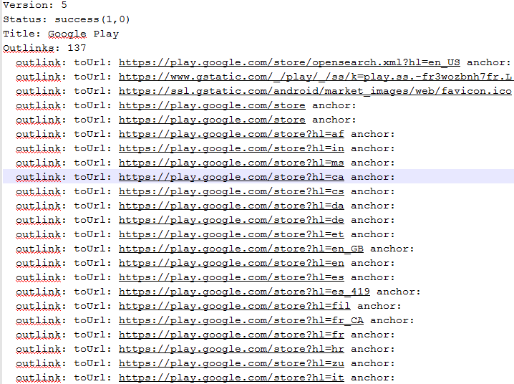
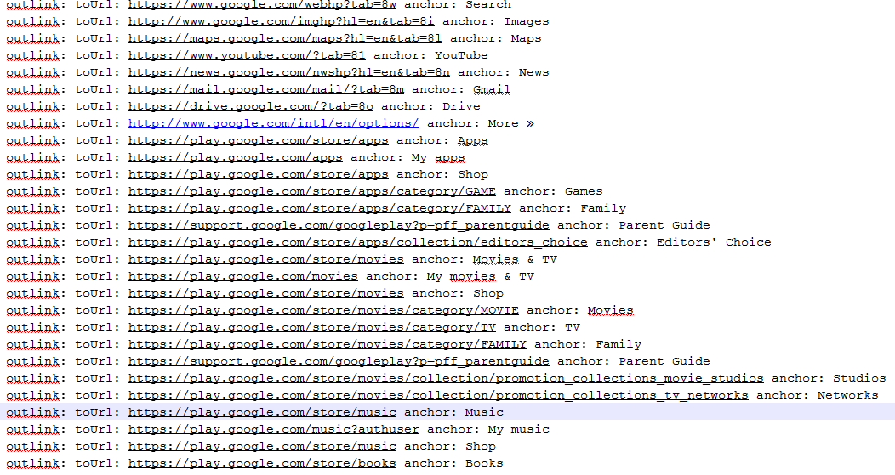
Parsing Google Play Store https://play.google.com/store
bin/nutch parsechecker -dumpText https://play.google.com/store > play.txt
Google Play Outlinks: 137
Anchor Tags
Images
Maps
Drive
My Apps
Games
Family
Movies
Shop
Parent Guide

Slide 22
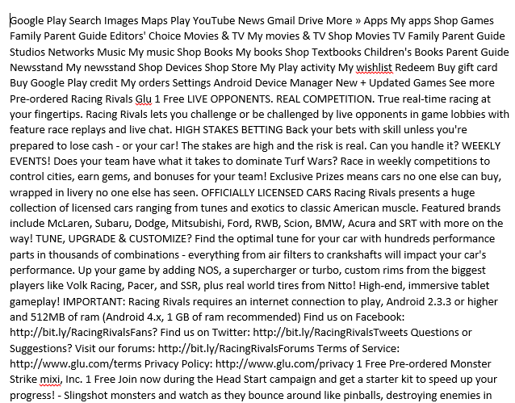
Parse Data Google Play Store

Slide 23
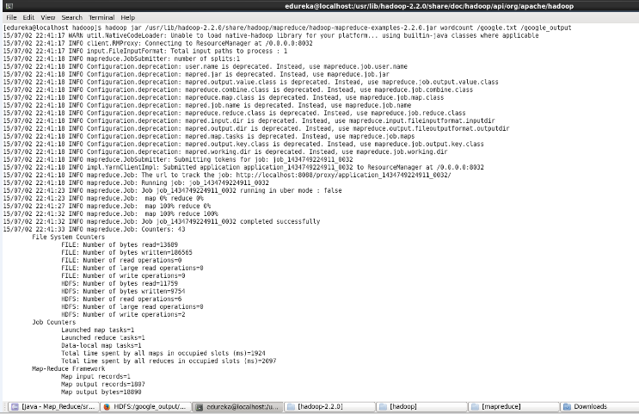
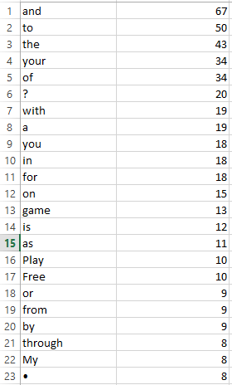
Word Count for Parse data from Google Play store (https://play.google.com/store)
Hadoop Map Reduce Word Count

Slide 24
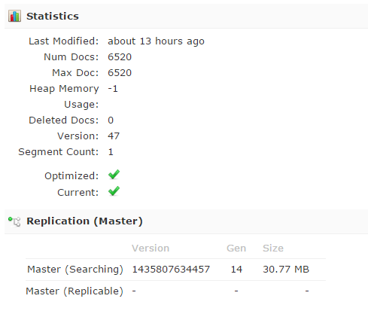
Improving Nutch Performance
Nutch-Default.xml
Nutch-site.xml
<property> <name>fetcher.threads.per.queue</name> <value>1</value> <description></description> </property> <property> <name>fetcher.threads.per.host</name> <value>1</value> <description></description> </property>
<property> <name>fetcher.threads.per.queue</name> <value>10</value> <description></description> </property> <property> <name>fetcher.threads.per.host</name> <value>10</value> <description></description> </property>
No of Threads per Queue | No of Docs | No of hours | Size
10 | 6520 | 2 hrs | 30.77 MB

Slide 25
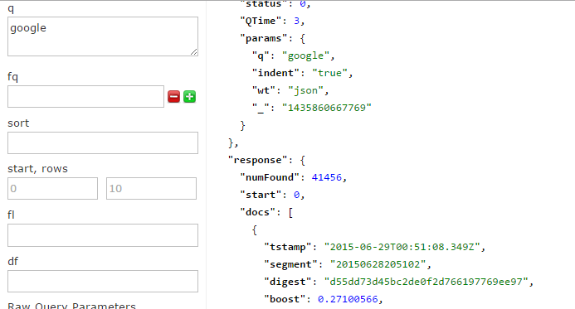
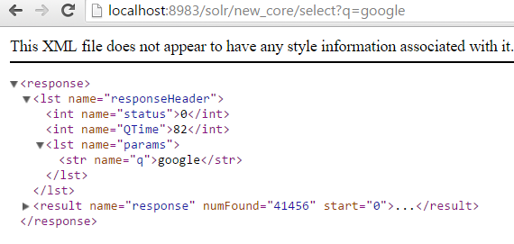
Querying Using Solr 5.2.1
http://localhost:8983/solr/new_core/select?q=google

